Slide 1


Swaraj Singh Rawat
07-12-2021

Slide 2

Outline
Executive Summary
Introduction
Methodology
Results
Conclusion
Appendix

Slide 3
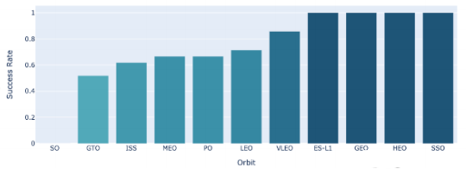
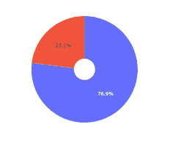
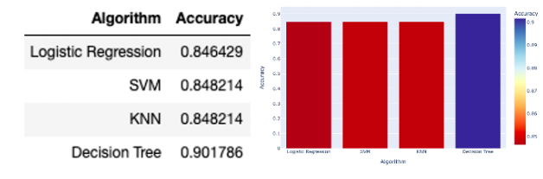
Executive Summary
Summary of methodologies Data collection via API, SQL and Web Scraping Data wrangling and analysis Interactive Maps with Folium Predictive Analysis for each classification model
Summary of all results Data analysis along with interactive Visualizations Best model for Predictive analysis

Slide 4
Introduction
Project background and context Here we will predict if the Falcon 9 first stage will land successfully. SpaceX advertises Falcon9 rocket launches on its website, with a cost of 62 million dollars; other providers cost upward of 165 million dollar each, much of the savings is because SpaceX can reuse its first stage. Therefore, if we can determine if the first stage will land successfully. This information can be used if an alternate company wants to bid against SpaceX for rocket launch
Problems you want to find answers With what factors, the rocket will land successful? The effect of each relationship of rocket variables on outcome. Condition which will aid SpaceX have to achieve the best results.

Slide 5


Slide 6
Methodology
Executive Summary
Data collection methodology:
Via SpaceX Rest API
Web Scraping from Wikipedia
Perform data wrangling
One hot encoding data fields for machine learning and dropping irrelevant columns (Transforming data for Machine Learning)
Perform exploratory data analysis (EDA) using visualization and SQL
Scatter and Bar graphs to show pattern between data
Perform interactive visual analytics using Folium and Plotly Dash
Using Folium and Plotly dash visulaizations
Perform predictive analysis using classification models
Build, tune, evaluate classification models

Slide 7
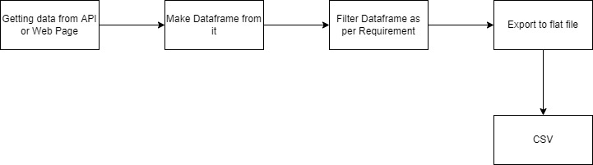
Data Collection
Data Collection is the process of gathering and measuring information on targeting variables in an established system, which then enables one to answer relevant questions and evaluate outcomes

Slide 8
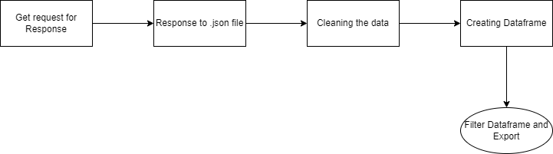
Data Collection – SpaceX API
First, we create a response object by get request on SpaceX url.
Then check the status and convert the response to json file.
Then we apply custom function to clean the data and saved it to a dataframe.
Then we filter the dataframe and export the file
URL:- Dala Collection API file

Slide 9
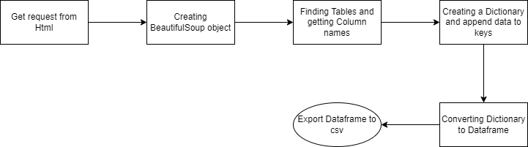
Data Collection - Scraping
First, Getting response from html
Then, creating a BeautifulSoup object
Then, find the table and Column names.
Then, Creating a dictionary and append data to keys
Converting data to dataframe and export it to csv
Add the GitHub URL of the completed web scraping notebook, as an external reference and peer-review purpose
Web Scraping file

Slide 10
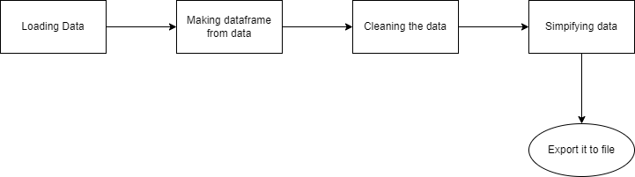
Data Wrangling
Data wrangling is the process of cleaning, structuring and enriching raw data into a desired format for better decision making in less time.
Converted the data to 0 (for bad outcomes) and 1 (for good outcomes)
Add the GitHub URL of your completed data wrangling related notebooks, as an external reference and peer-review purpose
Data Wrangling file

Slide 11
EDA with Data Visualization
Data wrangling is the process of cleaning, structuring and enriching raw data into a desired format for better decision making in less time.
Scatter Plot:- Payload vs Flight Number Flight Number vs Launch Site Payload vs Launch Site Flight Number and Orbit type Payload and Orbit type
Scatter plots’ primary uses are to observe and show relationships between two numeric variables. The dots in a scatter plot not only report the values of individual data points, but also patterns when the data are taken as a whole.
EDA with Data visualization file

Slide 12
EDA with Data Visualization
A bar chart is used when you want to show a distribution of data points or perform a comparison of metric values across different subgroups of your data.
Bar Graph:- Success rate vs Orbit type
Line Graph:- Launch Success yearly trend
A bar chart is used when you want to show a distribution of data points or perform a comparison of metric values across different subgroups of your data.

Slide 13
EDA with SQL
SQL (Structured Query Language) is used for performing various operations on the data stored in the databases like updating records, deleting records, creating and modifying tables, views, etc. SQL is also the standard for the current big data platforms that use SQL as their key API for their relational databases.
We are using IBM's db2 for cloud, which is fully managed SQL Database provided as a service.
!pip install sqlalchemy==1.3.9 !pip install ibm_db_sa !pip install ipython-sql %load_ext sql %sqlibm_db_sa://my-username:my-password@my-hostname:my-port/my-db-name %sql <your-query>
EDA with SQL

Slide 14
EDA with SQL
We performed SQL queries to gather information from given dataset:
Display the names of the unique launch sites in the space mission
Display 5 records where launch sites begin with the string 'CCA'
Display the total payload mass carried by boosters launched by NASA (CRS)
Display average payload mass carried by booster version F9 v1.1
List the date when the first successful landing outcome in ground pad was acheived.
List the names of the boosters which have success in drone ship and have payload mass greater than 4000 but less than 6000
List the total number of successful and failure mission outcomes
List the names of the booster_versions which have carried the maximum payload mass. Use a subquery
List the failed landing_outcomes in drone ship, their booster versions, and launch site names for in year 2015
Rank the count of landing outcomes (such as Failure (drone ship) or Success (ground pad)) between the date 2010-06-04 and 2017-03-20, in descending order

Slide 15
Build an Interactive Map with Folium
Folium is a Python library used for visualizing geospatial data. It is easy to use and yet a powerful library. Folium is a Python wrapper for Leaflet.js which is a leading open-source JavaScript library for plotting interactive maps.
Map Objects | Code | Result
Map Marker | folium.Marker( | Map object to make a mark on map
Icon Marker | folium.Icon( | Create an icon on map
Circle Marker | folium.Circle( | Create a circle where marker is being placed
Polyline | folium.Polyline( | Create a line between points
Marker Cluster Object | MarkerCluster( | This is a good way to simplify a map containing many markers having the same coordinate
AntPath | Folium.plugins.AntPath( | Create a animated line between points
Map with folium file

Slide 16
Build a Dashboard with Plotly Dash
Pie chart showing the total success for all sites or by certain launch site Percentage of success in relation to launch site
Scatter plot showing the correlation between payload and success for all sites or by certain launch site It shows the relationship between success rate and Booster version category
Map Objects | Code | Result
Dash and its Components | import dash import dash_html_components as html import dash_core_components as dcc From dash.dependencies import input,Output | Plotly stewards python's leading data viz and UI libraries. With dash open source, dash app runs on your local laptop or server. The dash core component library contains a set of higher level components like sliders, graphs, dropdowns, tables, and more dash provides all the available HTML tags as user friendly python classes
pandas | import pandas as pd | Fetching values from csv and creating dataframe
plotly | Import plotly.express as px | Plot a graphs with interactive plotly library
Dropdown | dcc.Dropdown( | Create a dropdown for launch sites
Rangeslider | Dcc.RangeSlider( | Create a rangeslider for payload mass range selection
Pie chart | Px.pie( | Creating a pie graph for success percentage display
Scatter plot | Px.scatter( | Creating the scatter graph for correlation display
Plotly file

Slide 17
Predictive Analysis (Classification)
Building Model | Evaluating Model | Finding the Best Model
Load our feature engineered data into dataframe Transform it to numpy arrays Standardize the transformed data Split data into training and test data sets Check how many test data samples has been created List down machine learning algorithm we want to use Set our parameters and algorithm to GridSearchCV objects and train our model | Check accuracy for each model Get best hyperparameters for each type of algorithms Plot confusion matrix | The model with best accuracy score wins the best performing model
Machine learning file

Slide 18
Results
Exploratory data analysis results
Interactive analytics demo in screenshots
Predictive analysis results

Slide 19


Slide 20
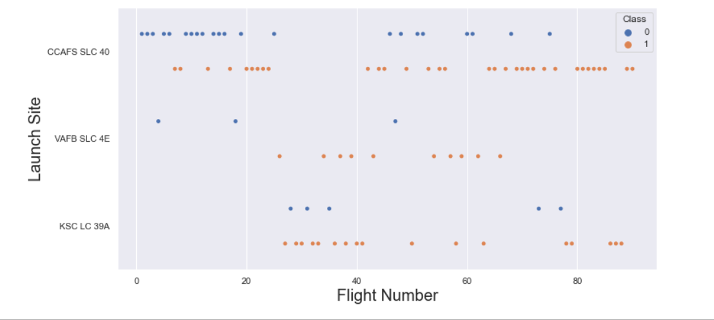
Flight Number vs. Launch Site
With high Flight number (Greater than 30) the success rate for the Rocket is increasing

Slide 21
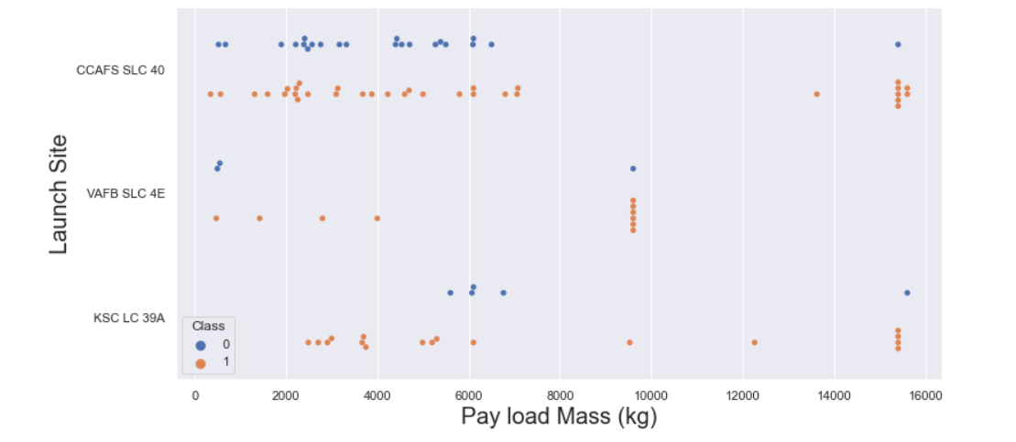
Payload vs. Launch Site
The greater the payload mass(greater than 7000kg) higher the success rate for the Rocket. But there is no clear patter to take a decision

Slide 22
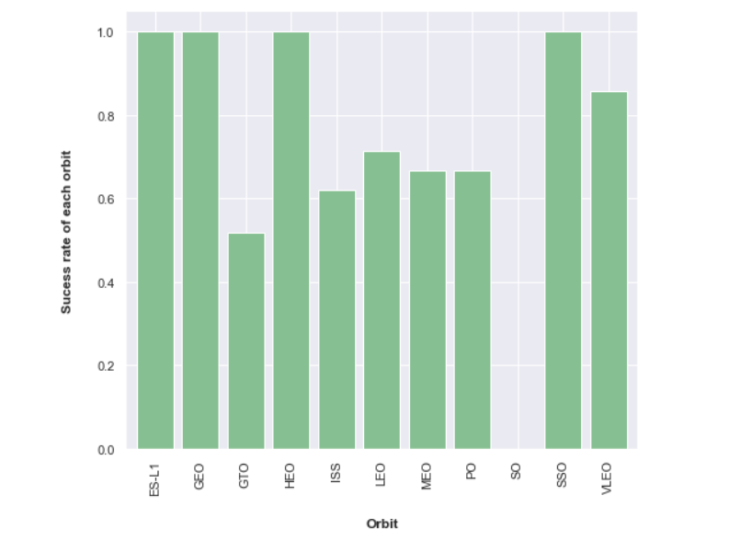
Success Rate vs. Orbit Type
ES-L1, GEO, HEO, SSO has high success rates.

Slide 23
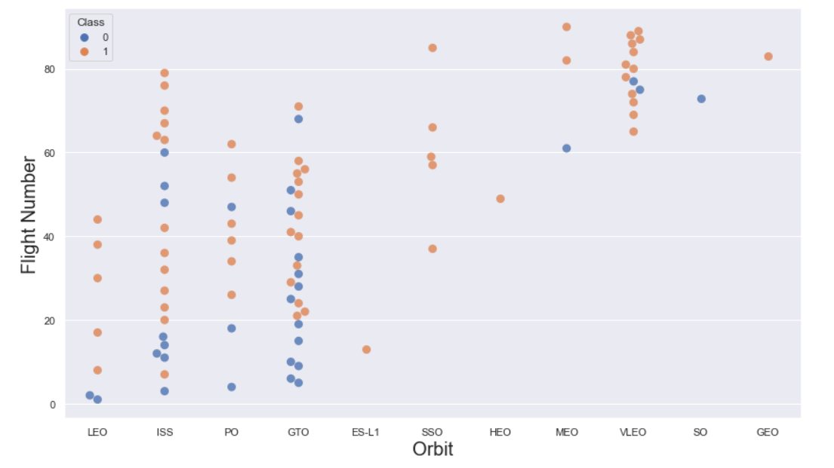
Flight Number vs. Orbit Type
We see that for LEO orbit the success rate increases with the number of flights.
There seems to be no relationship between flight number and the GTO orbit

Slide 24
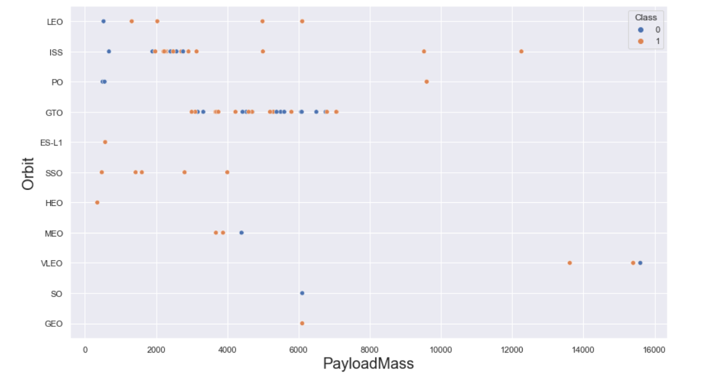
Payload vs. Orbit Type
Heavy payloads have a negative influence on MEO, GTO, VLEO orbits
Positive on LEO, ISS orbits

Slide 25
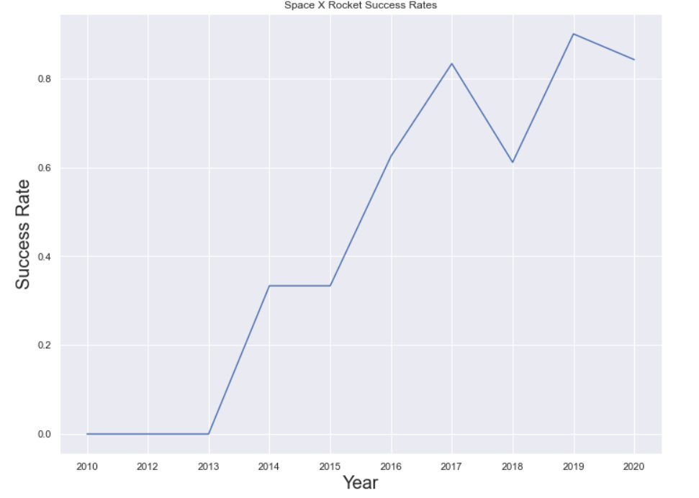
Launch Success Yearly Trend
Success rate increases since 2013 however there is slight dip after 2019

Slide 26
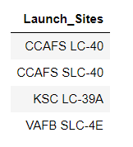
All Launch Site Names
Using the word DISTINCT in the query we pull unique values for Launch Site column from the table SPACEX

Slide 27
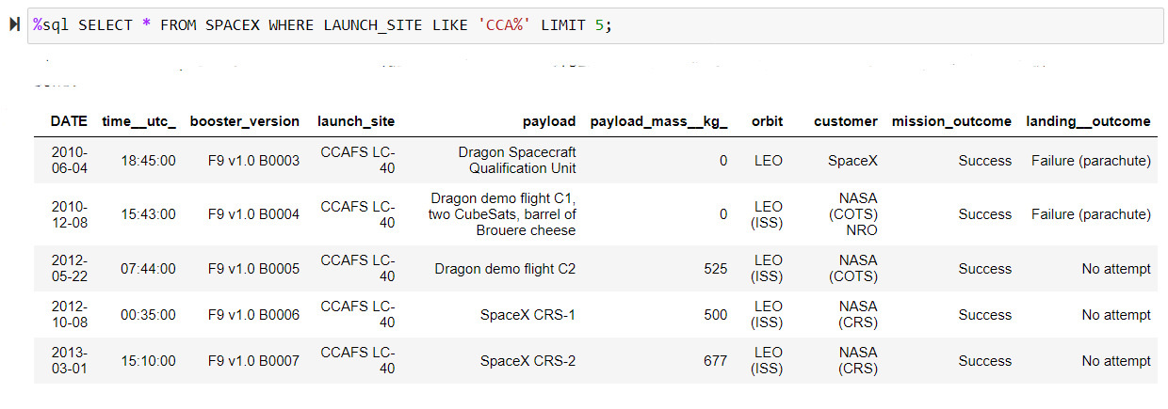
Launch Site Names Begin with 'CCA'
Using keyword LIMIT5 in the query we fetch 5 records from table spacex and with condition LIKE keyword with wild card :- CCA% . The percentage in the end suggests that the launch_site name must start with CCA

Slide 28
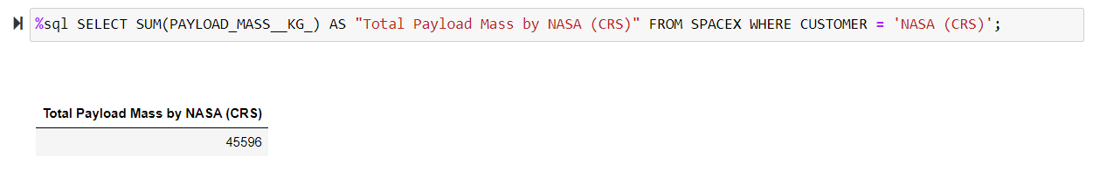
Total Payload Mass
Using the function SUM, calculates the total in the column PAYLOAD_MASS_KG and WHERE clause filters the data to fetch Customer's by name 'NASA (CRS)'.

Slide 29
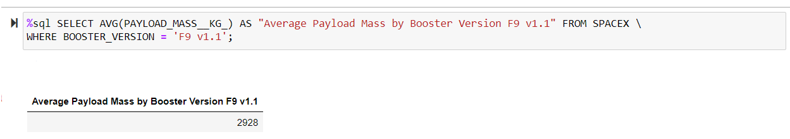
Average Payload Mass by F9 v1.1
Using the function AVG works out the average in the column PAYLOAD_MASS_KG_
The WHERE clause filters the dataset to only perform calculations on Booster_version 'F9 v1.1'.

Slide 30
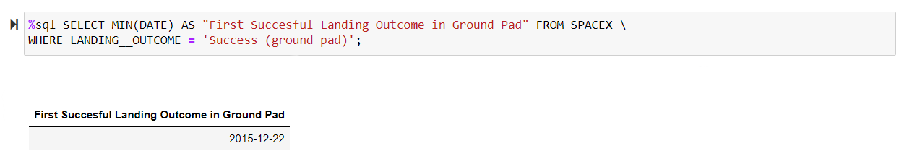
First Successful Ground Landing Date
Using the function MIN works out the minimum date in the column Date and WHERE clause filters the data to only perform calculations on Landing_outcome with value 'Success (ground pad)'

Slide 31
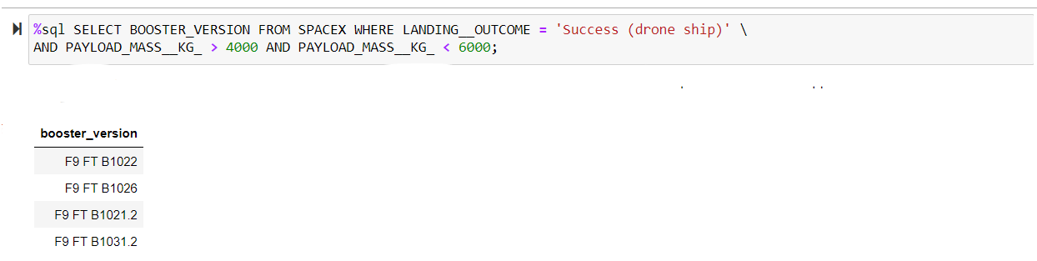
Successful Drone Ship Landing with Payload between 4000 and 6000
Selecting only Booster_Version, WHERE clause filters the dataset to Landing_Outcome = Success (drone ship)
AND clause specifies additional filter conditions PAYLOAD_MASS_KG_> 4000 AND Payload_Mass_KG_<6000

Slide 32
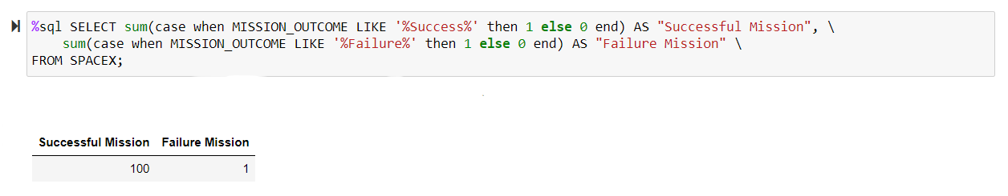
Total Number of Successful and Failure Mission Outcomes
Selecting multiple count is a complex query. I have used case clause within sub query for getting both success and failure counts in same query.
Case when MISSION_OUTCOME LIKE '%Success%' then 1 else 0 end returns a Boolean value which we sum to get the result needed

Slide 33
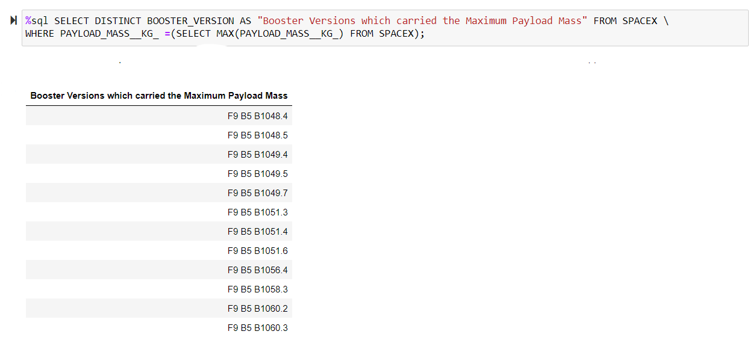
Boosters Carried Maximum Payload
Using the function MAX works out the maximum payload in the column PAYLOAD_MASS_KG_ in sub query.
WHERE clause filters Booster Version which had that maximum payload

Slide 34
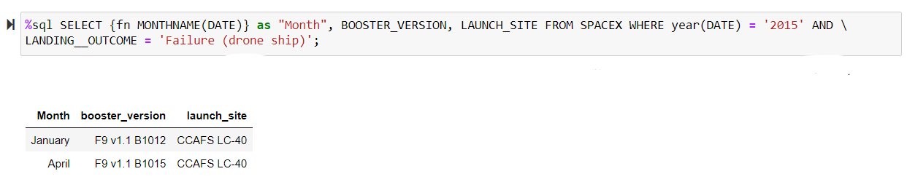
2015 Launch Records
We need to list the records which will display the month names, failure, landing_outcomes in drone ship, booster versions, launch site for the month in year 2015 via year function we extract the year and future where clause 'Failure (drone ship)' fetches our required values.
Also, I am using (fn MONTHNAME(DATE)) to get the month name

Slide 35
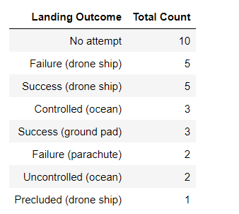
Rank Landing Outcomes Between 2010-06-04 and 2017-03-20
Selecting only Landing__Outcome. Where clause filters the data with DATE between '2010-06-04' and '2017-03-20'
Grouping by LANDING__OUTCOME Order by COUNT(LANDING__OUTCOME) in descending order.

Slide 36


Slide 37
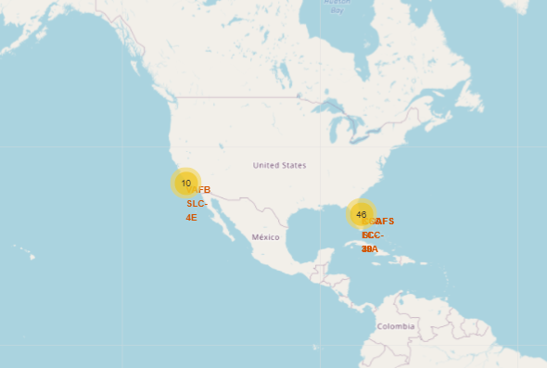
All Launch site on Folium map
We can see that the SpaceX launch sites are near to the United states of America coast i.e, Florida and California regions.

Slide 38
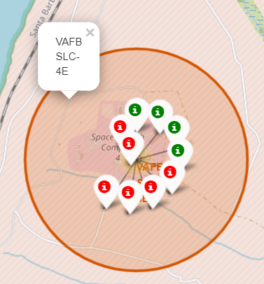
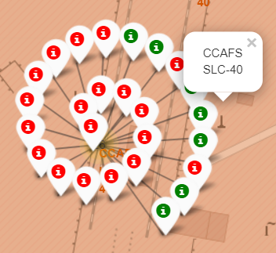
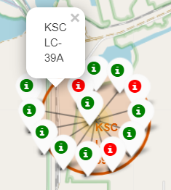
Color labeled launch Records
Green marker shows successful launches and Red marker shows failures. From these screenshots its easily understandable that KSC LC-39A has the maximum probability to success.

Slide 39
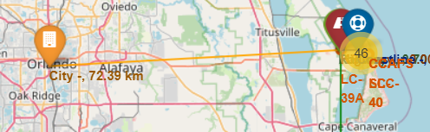
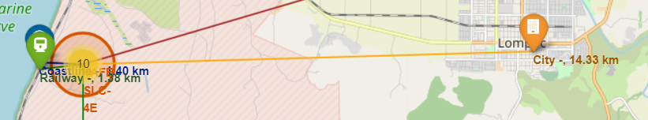
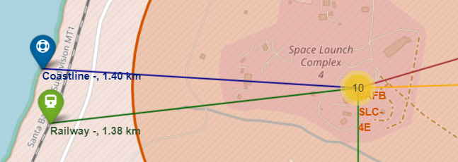
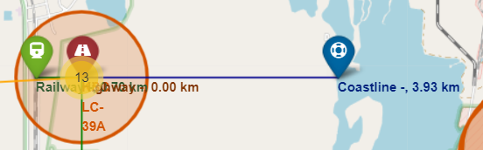
Launch site distance from Coastline & cities
Distance from all launch sites from cites is greater than 14km for all sites, So, launch sites are far away from cities

Slide 40
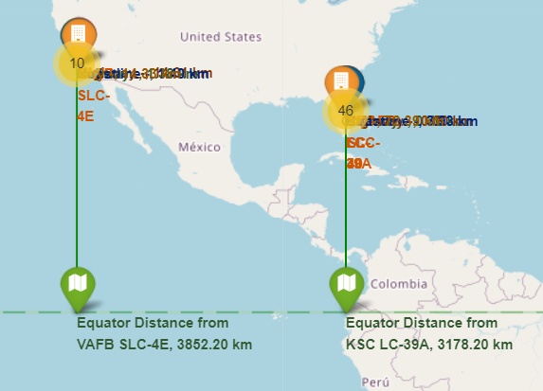
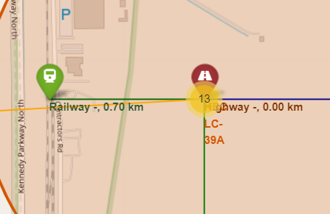
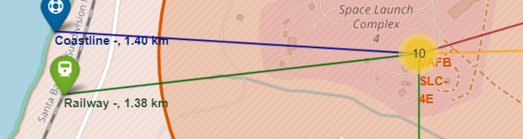
Launch site distances from Equator & Railways
Distance from equator is 3000km for all sites
Distance for all launch sites from railway track are greater than 0.7km for all sites. So, launch sites are not so far away from railway tracks

Slide 41


Slide 42
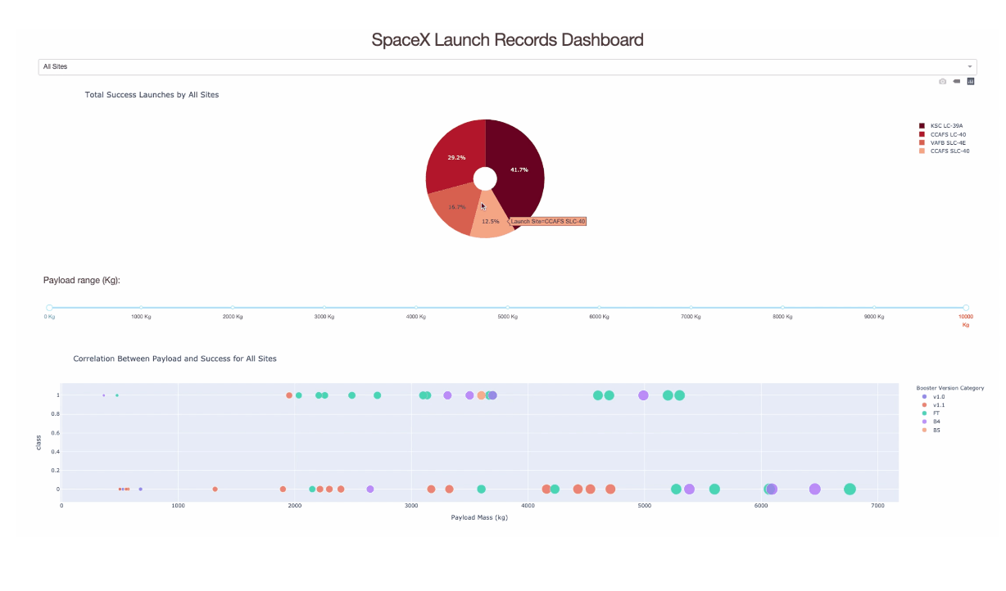
Launch Success count for all sites
We can see that KSC LC-39A had the most successful launches from all the sites
Plotly file​

Slide 43
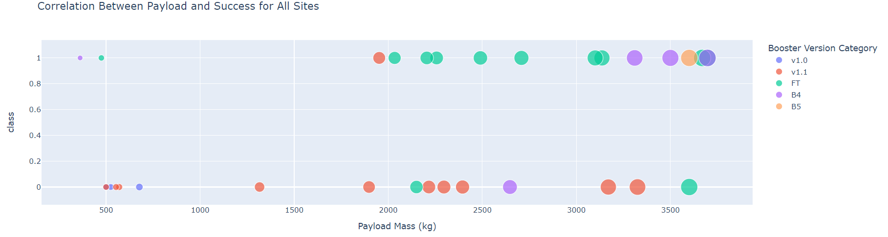
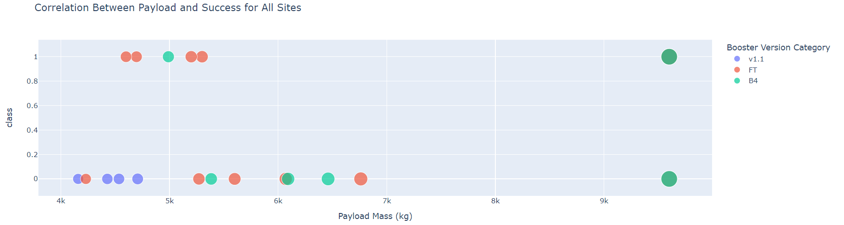
Payload vs Launch Outcomes Scatter Plot for all sites
We can see the success rates for all low weighted payloads is higher than the heavy weighted payloads.

Slide 44
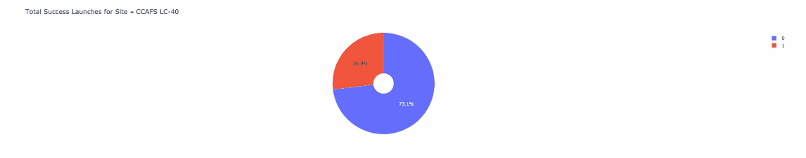
Launch Site with Highest Launch success ratio
KSC LC –39A achieved a 79.6% success rate while getting a 23.1% failure rate.
After visual analysis using the dashboard, we are able to obtain some insights to answer these questions:
Which site has the highest launch success rate? KSC LC –39A
Which payload range(s) has the highest launch success rate? 2000kg - 10000kg
Which payload range(s) has the lowest launch success rate? 0-1000kg
Which F9 Booster version (v1.0, v1.1, FT, B4, B5 etc.) has the highest launch success rate? FT

Slide 45


Slide 46
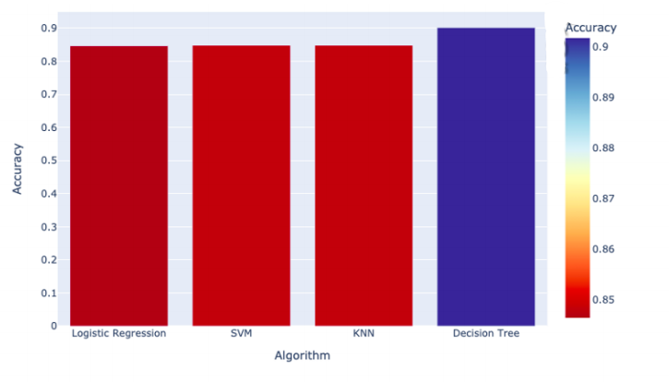
Classification Accuracy
As you can see our accuracy is extremely close, but we do have a clear winner which perform best - "Decision Tree" with a score of 0.90178
We trained four different models which each had an 83%accuracy rate.
Algorithm | Accuracy | Accuracy on test data | Tuned Hyperparameter
Logistic Regression | 0.846429 | 0.833334 | {'C':0.01, 'penalty':'12','solver':'lbfgs'}
SVM | 0.848214 | 0.833334 | {'C':1.0,'gamma':0.03162277,'kernel':'sigmoid'}
KNN | 0.848214 | 0.833334 | {'algorithm': auto, 'n_neighbours': 10, 'p':1}
Decision Tree | 0.901786 | 0.833334 | {'criterion':gini, 'max_depth': 10, 'max_features':'sqrt', 'min_samples_leaf': 1, 'min_samples_split':2, 'splitter': best}
46

Slide 47
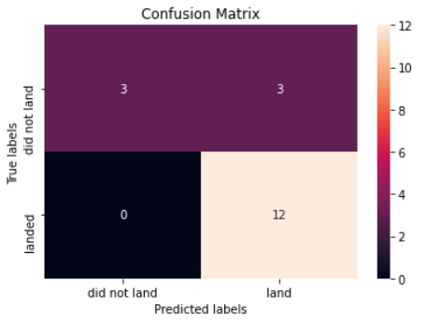
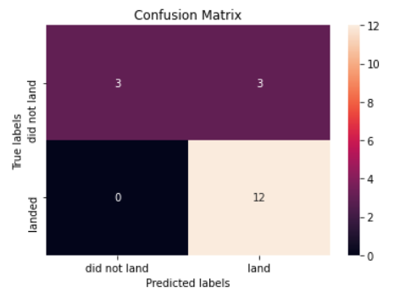
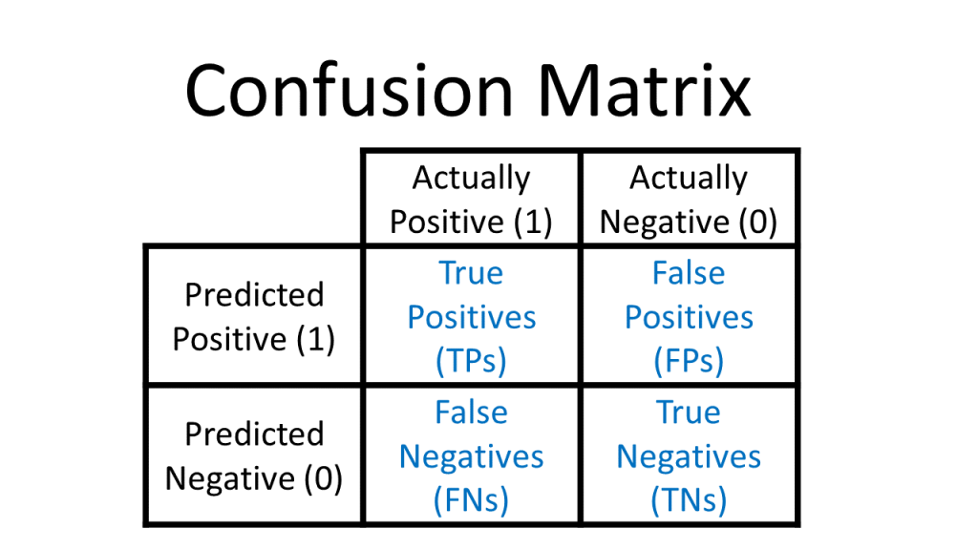
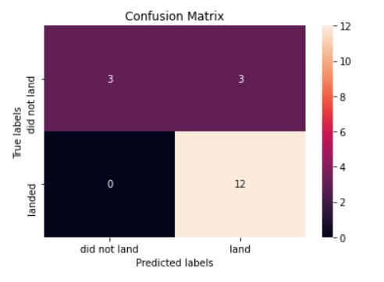
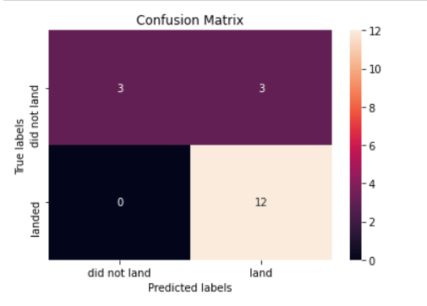
Confusion Matrix
Out here for all models unfortunately, we have same confusion matrix
Decision Tree
KNN
Accuracy: (TP+TN)/Total = (12+3)/18=0.8333
Misclassification Rate:(FP+FN)/Total = (3+0)/18 = 0.1667
True Positive Rate : TP/Actual Yes = 12/12 = 1 False Positive Rate : FP/Actual No = 3/6 = 0.5 True Negative Rate : TN/Actual No = 3/6 = 0.5 Precision : TP/Predicted Yes = 12/15 = 0.8 Prevalence : Actual Yes/ Total = 12/18 = 0.6667
Logistic Regression
SVM

Slide 48
Conclusions
Orbits ES-L1, GEO, HEO, SSO has highest Success rates
Success rates for SpaceX launches has been increasing relatively with time and it looks like soon they will reach the required target
KSC LC-39A had the most successful launches but increasing payload mass seems to have negative impact on success
Decision tree classifier algorithm is the best for machine learning model for dataset

Slide 49
Appendix
Interactive Plotly
Folium Measure Control plugin tool
Folium custom title layers with labels
Ibm Cognos Visualization tool
Basic Decision tree construction

Slide 50
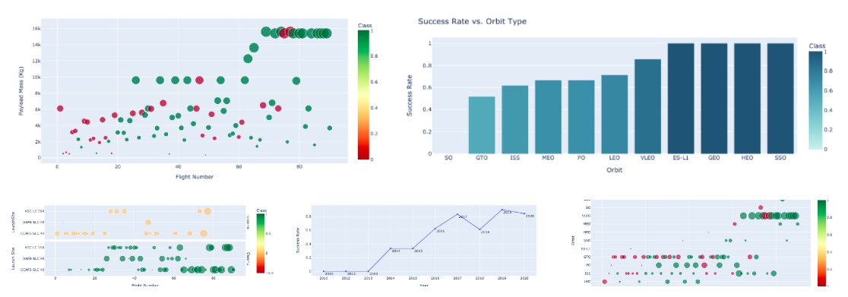
Interactive Plotly
Used plot instead of seaborn. They are more interactive and easily customizable as well.
Plotly file​

Slide 51
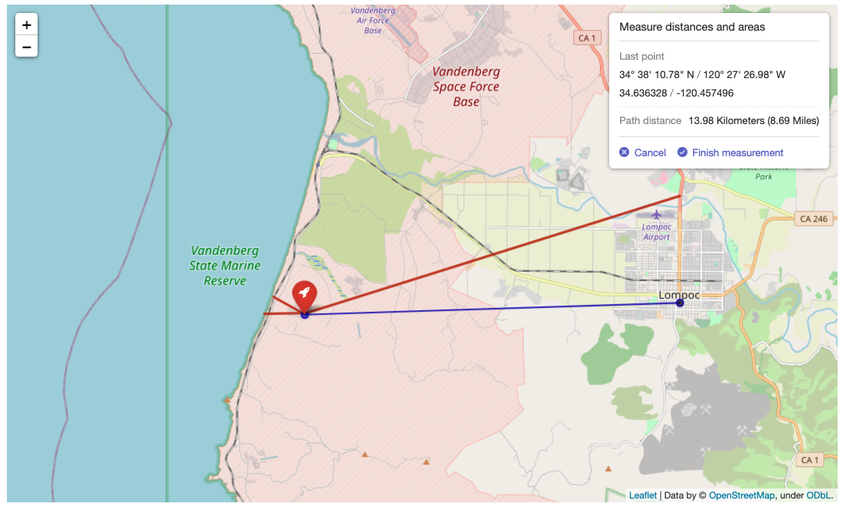
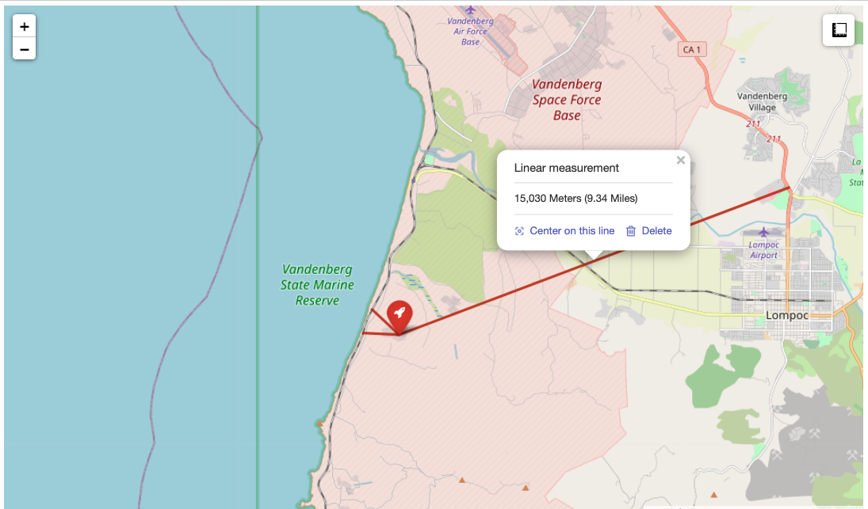
Folium Measure Control Plugin Tool
With measure Control plugin tool, we don't need to write manual distance calculation code and it's very easy to use.

Slide 52
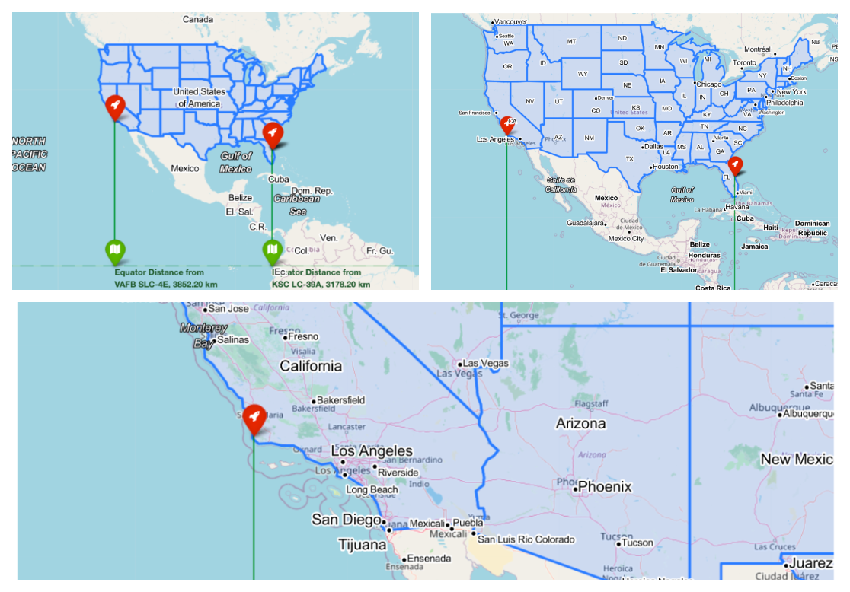
Folium Custom Title layers with labels
Created custom title layer to understand the locations of launch site in a better way.

Slide 53
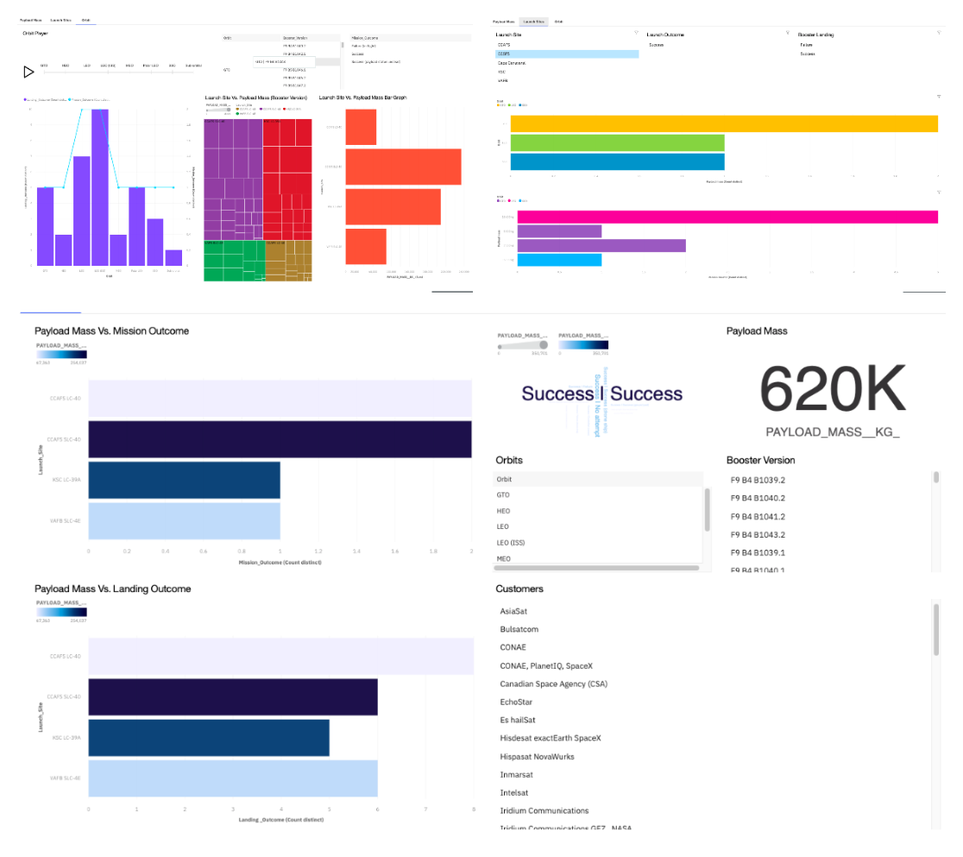
IBM Cognos Visualization Tool
IBM Cognos Analytics provides analytic insights that help you to detect and validate important relationships and meaningful differences based on the data that is presented by the visualization

Slide 54
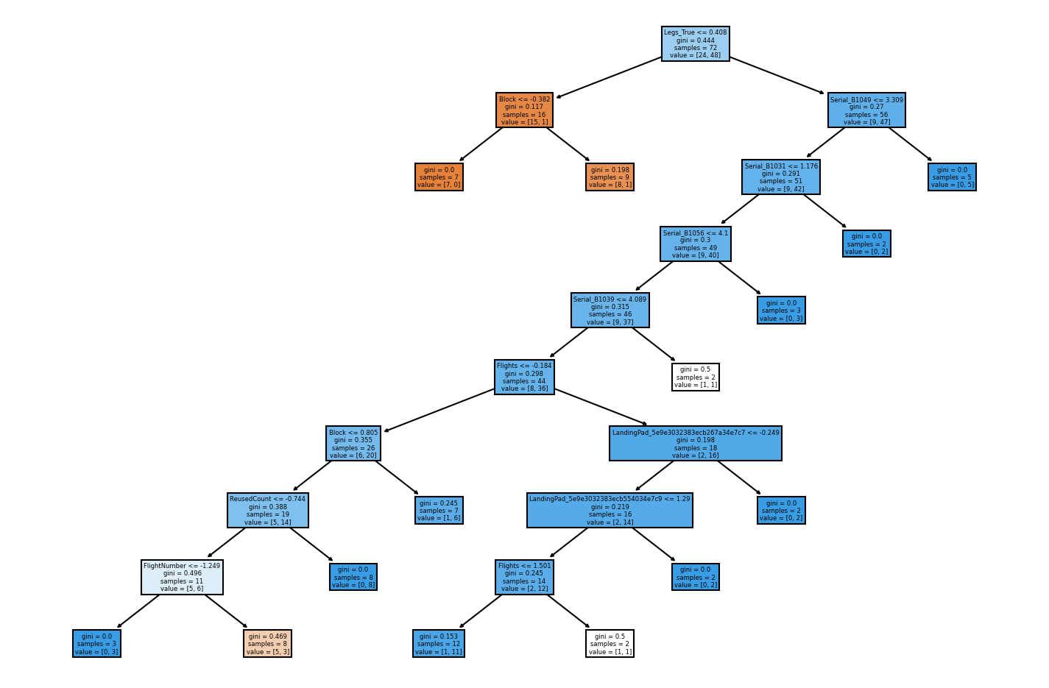
Basic Decision Tree Construction
Decision tree has been constructed, with decision tree model .We can see that we have reached Gini impurity almost near to 0 via the tree model . From this we can determine the correct combination of condition where the probability of the success will be highest.

Slide 55


